Slide 1
Phishing URL Detection Using Ridge- and Lasso-Regularised Logistic Regression
UNDER THE GUIDANCE OF ASIF SHAIK
An Intelligent Machine Learning Approach for Detecting Malicious URLs and Enhancing Online Security
TEAM
P Ashwika (2520030224)
Vennela E (2520030288)

Slide 2

INTRODUCTION
Phishing is a common cybersecurity threat in which attackers create deceptive URLs and websites to trick users into revealing sensitive information. Traditional detection methods, such as blacklists, may not always identify newly created or modified phishing URLs.Our project, “Phishing URL Detection Using Ridge- and Lasso-Regularised Logistic Regression,” uses machine learning to classify URLs as ˡᵉᵍᶦᵗᶦᵐᵃᵗᵉ ᵒʳ ᵖʰᶦˢʰᶦⁿᵍ based on their URL characteristics. We perform Exploratory Data Analysis (EDA) to understand the dataset and identify useful patterns, then apply Logistic Regression with Ridge and Lasso ʳᵉᵍᵘˡᵃʳᶦˢᵃᵗᶦᵒⁿ to build and compare phishing detection models. The goal is to develop a simple, efficient, and interpretable approach for detecting suspicious URLs.

Slide 3
OBJECTIVES
  To detect phishing URLs and classify them as legitimate or phishing.
  To analyse URL characteristics such as length, special characters, domain indicators, and security-related features.
  To perform EDA to identify patterns and relationships within the dataset.
  To develop a Logistic Regression model for phishing URL classification.
  To apply Ridge and Lasso regularisation to reduce overfitting and improve model performance.
  To compare the models using accuracy, precision, recall, F1-score, and confusion matrix.
  To develop a reliable and interpretable approach for detecting suspicious URLs.

Slide 4
DATASET
  Dataset: Phishing URL Dataset (phishing_url_dataset 2.xlsx)
  Size: 2,488 URL samples × 14 attributes
  Target: Binary classification — Legitimate (0) and Phishing (1)
  Features: URL length, path length, HTTPS status, special-character counts, suspicious-word count, domain indicators, and other URL-based features.
https://1drv.ms/x/c/AED7D1AB2F3C8FC3/IQDEvNhH38QgR6yhF0XRUudhAdGf3jKS13kB5xtrU3wTyqc?e=ySoixW
our dataset is fairly balanced:
  Legitimate: 1,313 → 52.77%
  Phishing: 1,175 → 47.23%

Slide 5
Modules Used In Our Project
Module 1 — Data Understanding & ML Pipeline
CO1
CO1 focuses on understanding the dataset and following the complete ML lifecycle through EDA and data preparation..
We identified and analysed the phishing URL dataset using EDA.
We examined feature distributions, class balance, and relationships between URL features.
This prepared the dataset for model training, evaluation, and prediction.
Module 2 — URL Feature Engineering & Preprocessing
CO2
CO2 focuses on applying Logistic Regression with Ridge and Lasso regularisation for URL classification.
We used Logistic Regression to classify URLs as legitimate or phishing.
Ridge and Lasso regularisation were applied to control model complexity and reduce overfitting.
The models were used to identify the most effective approach for phishing URL phishing.
Module 3 — Tree-based supervised learning
CO3
CO3 focuses on applying tree-based machine-learning models for phishing URL classification.
We can use Decision Tree and Random Forest models to classify URLs as legitimate or phishing.
These models help identify important URL features using tree-based splitting and feature importance.
Their performance can be compared with our Logistic Regression, Ridge, and Lasso models.
Module 4 —Unsupervised learning
CO4
CO4 focuses on applying unsupervised learning techniques to analyse patterns and relationships in data.
We can apply PCA to reduce the dimensionality of the URL feature set. This helps visualise the underlying patterns and relationships among the URL features. The reduced feature representation can support exploratory analysis before classification.
Module 5 — Model evaluation
CO5
  CO5 focuses on evaluating and comparing machine-learning models using appropriate performance metrics.
  We evaluate our models using accuracy, precision, recall, F1-score, and confusion matrix.
  These metrics help measure how effectively the models detect phishing and legitimate URLs.
  We compare the model performances to identify the most suitable approach for phishing URL detection.
Module 6 — Deployment & ML engineering
CO6:
CO6 focuses on applying ML engineering practices to package, deploy, and monitor the trained phishing URL detection model.
We can package the trained model into a simple phishing URL detection application or REST API.
The application can accept a URL and return its predicted class and confidence.
The deployed model can be monitored and updated using new URL data over time

Slide 6
EDA (Explanatory Data Analysis)
  Dataset shape: 2,488 rows × 14 columns.
  Target distribution: 1,313 legitimate URLs and 1,175 phishing URLs.
  Missing-value analysis: Checked the dataset for missing values.
  Duplicate analysis: Checked for duplicate URL records.
  Feature distribution: Analysed features such as URL length, path length, number of dots, hyphens, www, and sensitive words.
  Class-wise comparison: Compared URL characteristics between legitimate and phishing URLs.
  Correlation analysis: Examined relationships between numerical features to identify related or redundant variables.

Slide 7
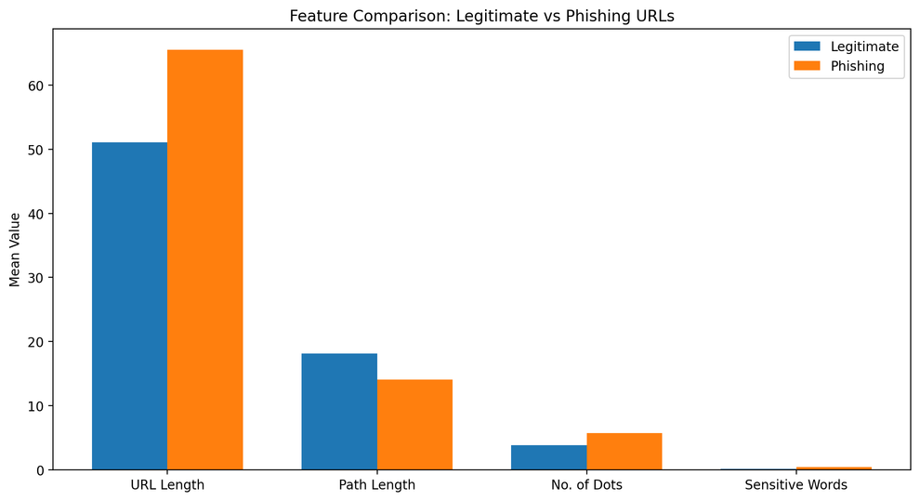
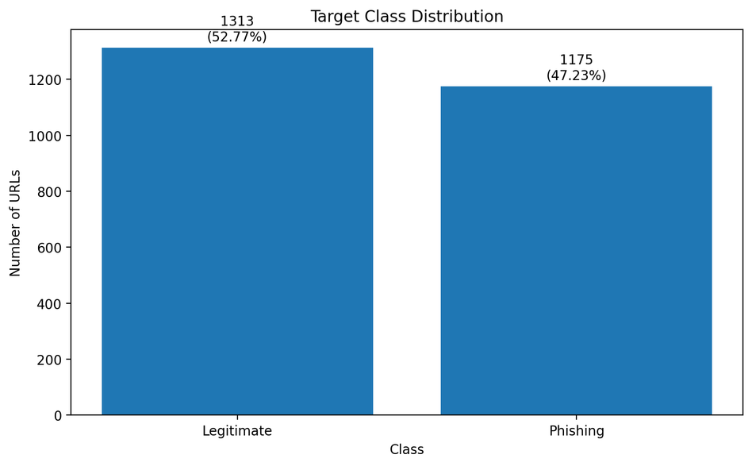
EDA Observation
  The dataset contains two relatively balanced classes, making it suitable for binary classification.
  URL characteristics show different patterns between legitimate and phishing URLs.
  Features related to URL structure and suspicious elements provide useful information for classification.
  Correlation analysis helps understand relationships among the input features before applying Logistic Regression.

Slide 8
CORREALTION ANALYSIS
In our phishing URL dataset, we analysed features such as URL length, path length, number of dots, hyphens, www, sensitive words, and HTTPS status. A correlation heatmap was used to visually represent these relationships.
  A positive correlation means that when one feature increases, the other tends to increase as well.
  A negative correlation means that when one feature increases, the other tends to decrease.
  A correlation close to 0 indicates little or no linear relationship.
  The analysis helps us identify which features contain useful information for distinguishing phishing URLs from legitimate URLs and whether some features are strongly related to each other.

Slide 9
PROPOSED METHADOLOGY
  Our proposed methodology follows a systematic machine-learning approach for detecting phishing URLs. First, the labelled dataset is collected and preprocessed, followed by Exploratory Data Analysis (EDA) to understand the data, feature patterns, and correlations. Relevant URL-based features are then used to train a Logistic Regression model, along with Ridge (L2) and Lasso (L1) regularisation to control model complexity and reduce overfitting. Finally, the models are evaluated and compared using accuracy, precision, recall, F1-score, and confusion matrix, and the best-performing model can be used to classify new URLs as legitimate or phishing.

Slide 10
LOGISTIC REGRESSION
  Logistic Regression is a supervised machine-learning algorithm used for binary classification. In our project, it is used to predict whether a given URL is legitimate (0) or phishing (1) based on URL-related features such as URL length, path length, HTTPS status, special characters, and suspicious words.
  The model calculates the probability of a URL belonging to the phishing class and then assigns it to one of the two classes based on a classification threshold. Logistic Regression is suitable for our project because it is simple, efficient, and interpretable, and it provides a strong baseline for comparing the effects of Ridge and Lasso regularisation.

Slide 11
Ridge & Lasso Regularisation
Ridge and Lasso regularisation are techniques used with Logistic Regression to control model complexity and reduce overfitting.
Ridge (L2) regularisation adds a penalty based on the squared values of the model coefficients, encouraging the coefficients to remain small.
Lasso (L1) regularisation adds a penalty based on the absolute values of the coefficients and can reduce some coefficients to zero, which helps with feature selection.

Slide 12
Research Papers & Related Work
We have the research papers in the form of the pdf's BELOW:
https://drive.google.com/file/d/15sLhWJ8YCyUJ1E0x9UBlHQEmsA4RkMPQ/view?usp=sharingh text
https://drive.google.com/file/d/1UOdz7lO1bWQxkDIO9N65J0NW6CPq8F7L/view?usp=sharing

Slide 13
Model Evaluation Metrics
  Model evaluation metrics are used to measure and compare how accurately our Logistic Regression, Ridge, and Lasso models detect phishing URLs.
  Accuracy: Measures the overall percentage of correctly classified URLs.
  Precision: Measures how many URLs predicted as phishing are actually phishing.
  Recall: Measures how many of the actual phishing URLs are correctly detected.
  F1-Score: Provides a balance between precision and recall.
  Confusion Matrix: Shows the numbers of true positives, true negatives, false positives, and false negatives.

Slide 14
FUTURE SCOPE
  The future scope of our project is to improve the phishing URL detection system and make it more practical for real-world use. The trained model can be deployed as a web application or REST API where users can enter a URL and receive an immediate prediction. The system can also be improved by using larger and continuously updated datasets, adding more advanced URL and website features, and comparing the proposed models with other machine-learning techniques. In the future, the model can also be monitored and retrained regularly to adapt to new phishing patterns.

Slide 15
THANK YOU

